Slide 1
Art Bonus
.
Carolina Botti
www.artbonus.gov.it

Slide 2
Access to finance for cultural institutions
Given the complexity of the issue, access to finance for cultural institutions needs to be placed in the perspective of:
current economic and social context
political reflection on the sectors’ potential for growth, innovation, job creation and social welfare
I will focus not on financial instruments, such as loans and equities, but on alternative financing, such as public-private funds, in particular donations and philanthropy.

Slide 3
Art bonus framing
Art Bonus Framing
“Art Bonus” has been a political investment to address not only the need for funding from cultural institutions, but also the social need to recover citizens’ relationship with cultural heritage and to generate, through the management of cultural heritage, a socio-economic driving force in the territory

Slide 4
Art Bonus: a tax bonus for those who support culture
Law 29 luglio 2014, n. 106, "Disposizioni urgenti per la tutela del patrimonio culturale, lo sviluppo della cultura e il rilancio del Turismo", articolo 1, comma 1:
This law introduces a new favorable tax regime for those who support culture with charitable donations.
It's called Art Bonus, and it is a tax credit equal to 65 % of charitable contributions that individuals or companies make mainly in favor of public cultural heritage.
The Art Bonus is revolutionary for our country, which has a unique cultural heritage: every citizen can contribute to protecting Italy’s cultural heritage, and passing it on to the next generations with this simple gesture.

Slide 5
Where it applies
The tax credit “Art Bonus” is granted to individuals, to non-profit organizations and businesses for charitable contributions destined to the following:
-maintenance, protection and restoration of public cultural works (eg. monuments, historic buildings, works of art) ;
-support of public cultural institutions (eg. museums, libraries, archives, archaeological areas and parks), opera/symphonic foundations, traditional theater and other music, dance, theater institutions;
-realization, restoration and upgrading of facilities of public institutions dedicated to performances.
Not only investment in tangible assets but also cultural activities that are driving growth, in today’s creative economy

Slide 6
Critical success factors to make it works
Associate a support service to the law: in this case the MiBACT in-house company Ales has been the public-private interface promoting and monitoring the law and its implementation.
Minimal bureaucracy: Make easy to donate
When identified a cultural work to which the donor would like to contribute, he/she should make a money transfer (through a bank, post office, debit or credit and debit cards, bank checks), and save the receipt of the Art Bonus transaction to take advantage of the tax benefits.
Transparency: all collections and donations can be consulted on the website www.artbonus.gov.it

Slide 7
Results to date: economic value
To date we have reached
380 million charitable donations,
with 1700 beneficiaries, over 2000 interventions and over 12500 patrons
Data collected from the database www.artbonus.gov.it

Slide 8
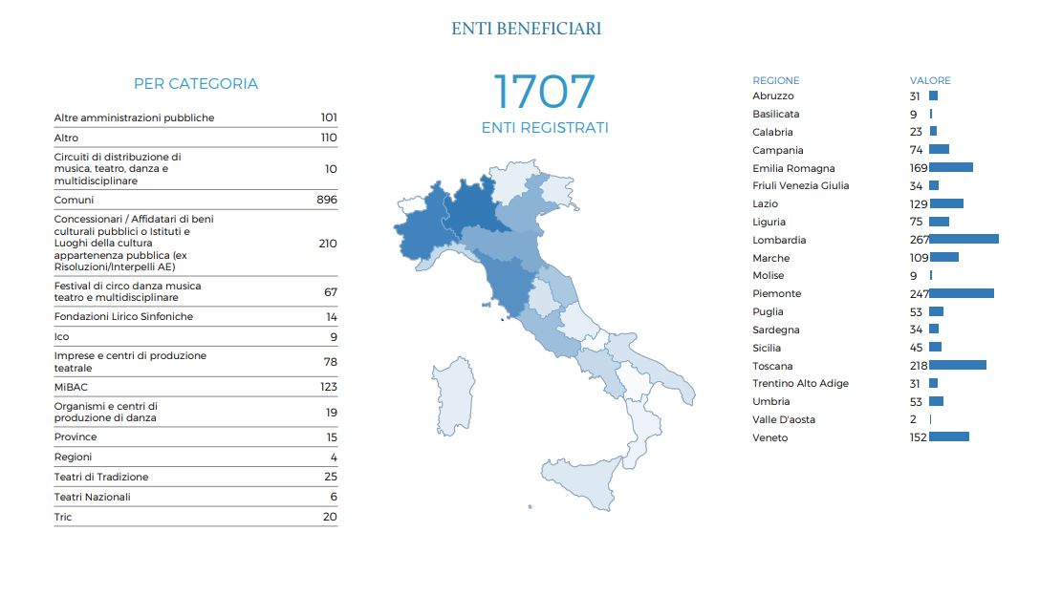
Who is asking

Slide 9
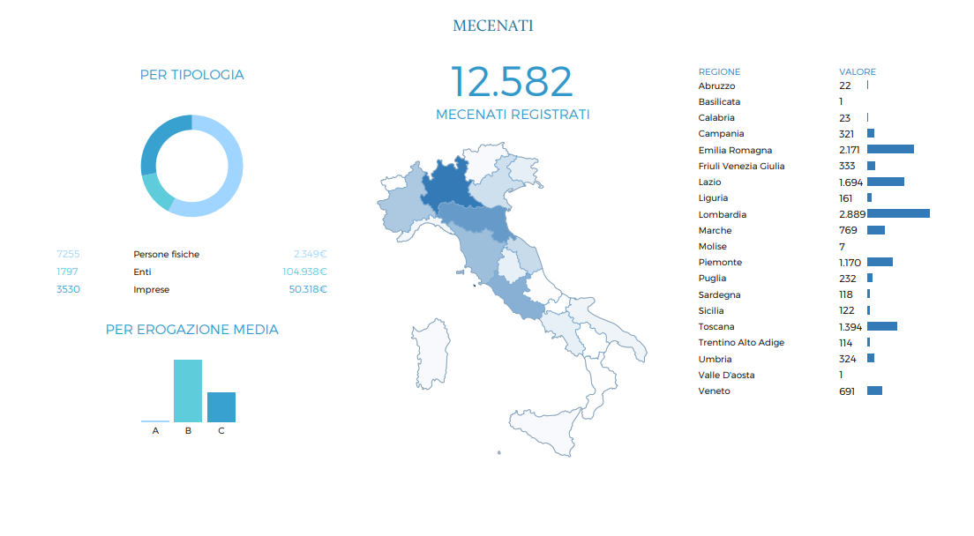
Who is giving

Slide 10
But the most important…social value
It has raised awareness about the ethical value of protecting artistic-historical
heritage, and that taking care of cultural heritage is everyone’s civic duty
“Third millennium patrons” is the name we now give to those more than 12,500 people who make donations ranging between 10 euros and several hundred thousand euros helping cultural institutions to finance their activities.

