Slide 1
ChIMERA
Final event
Venue : Trieste Terminal Passeggeri - Centro Congressi Molo IV - Sala 3
date 26 – 27 SEPTEMBER 2019
Aleš Pevc
Technology Park Ljubljana
ales.pevc@tp-lj.si

Slide 2
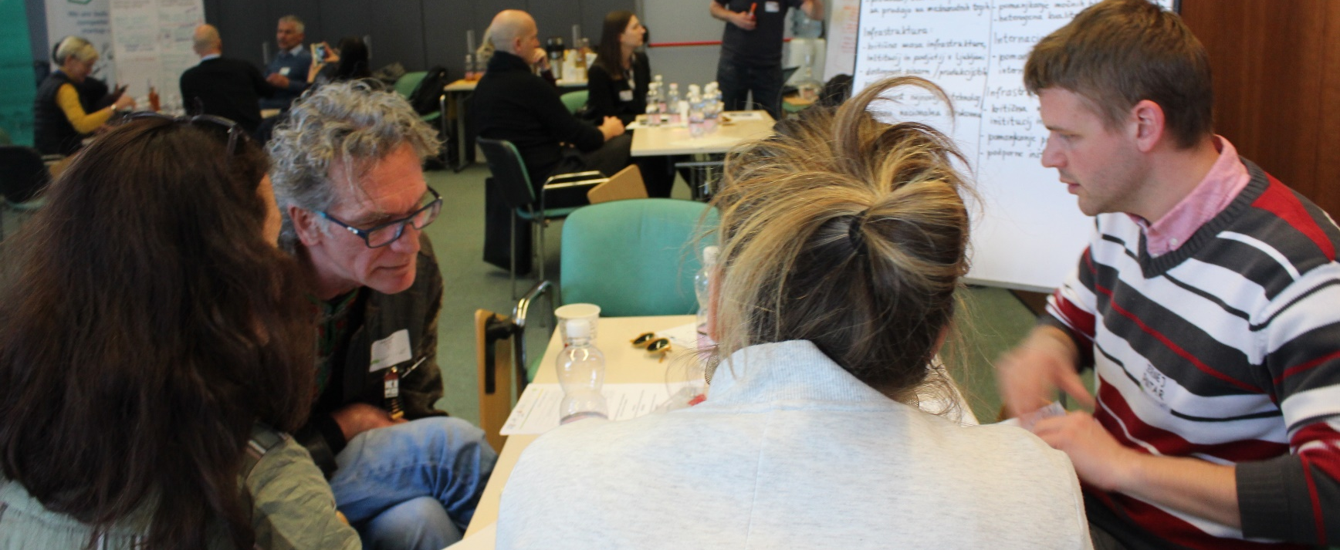
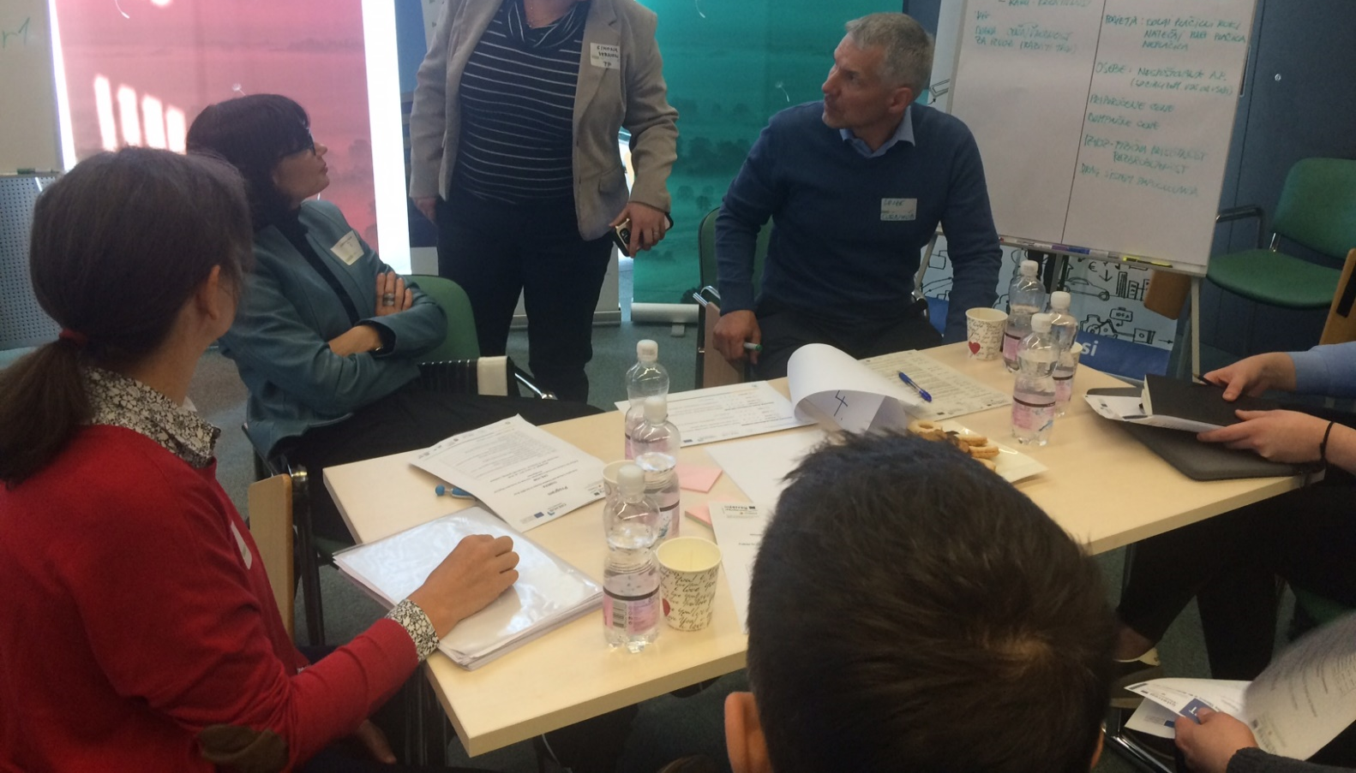
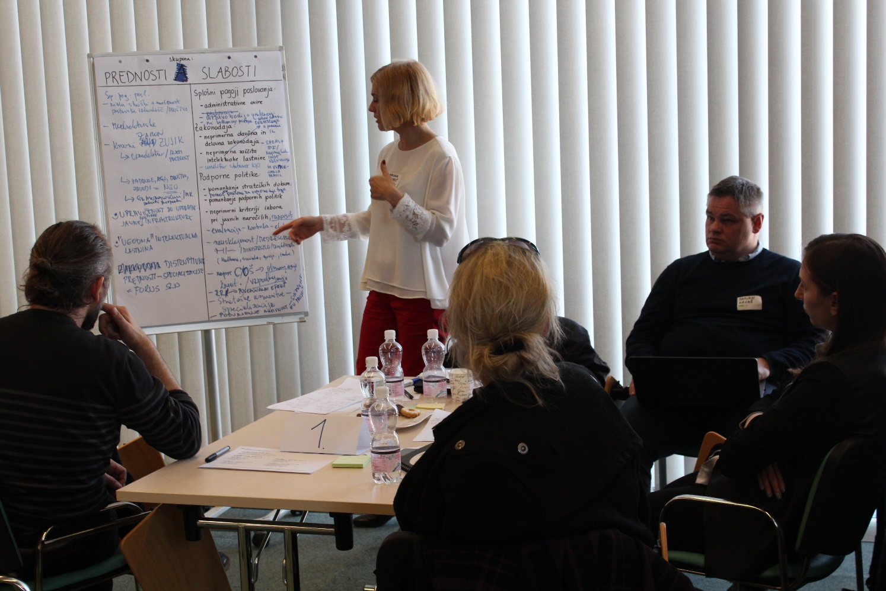
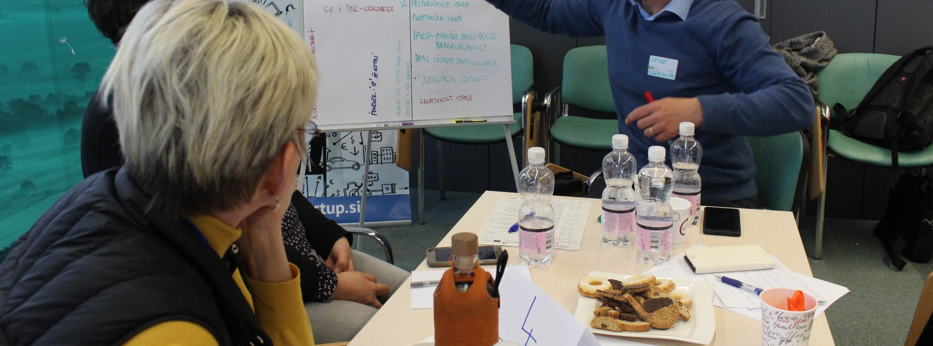
Start of cooperation of all CCS stakeholders

Slide 4
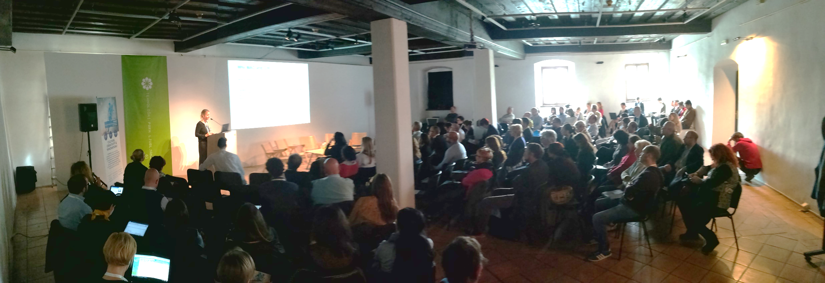
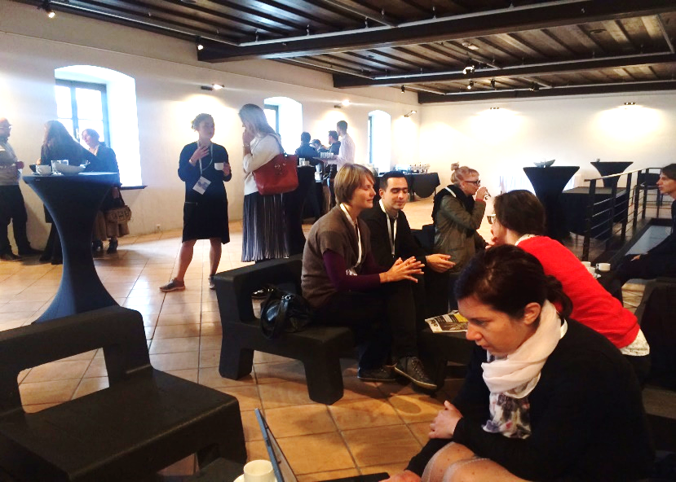
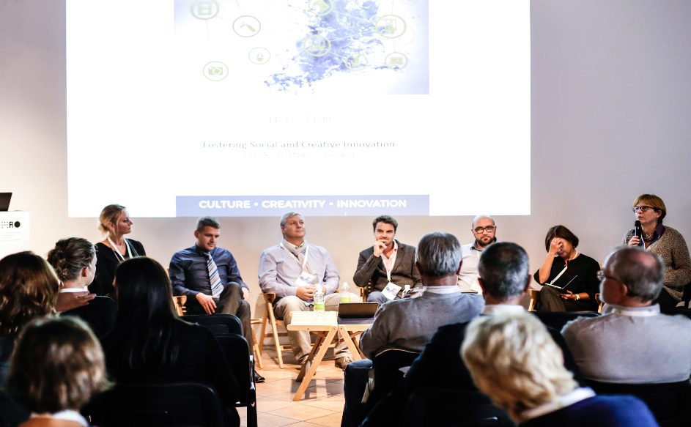
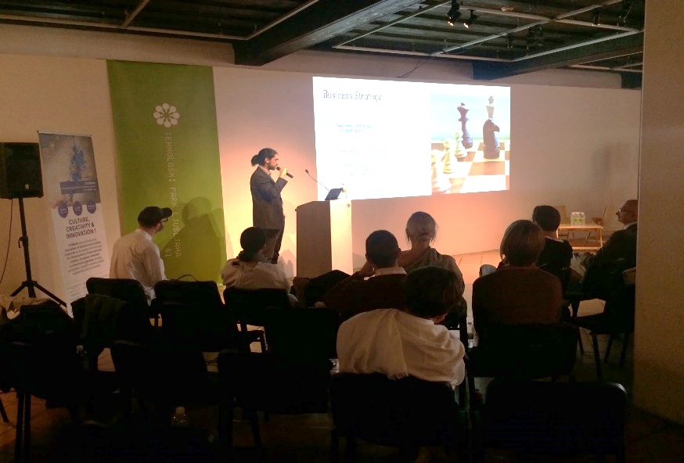
More than 200 participants
9 startups
11 investors

Slide 6
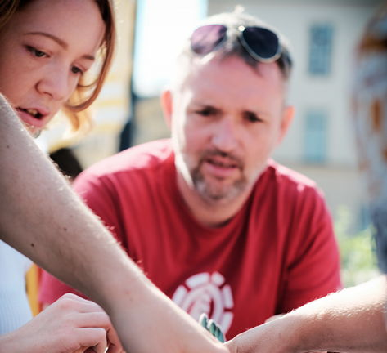
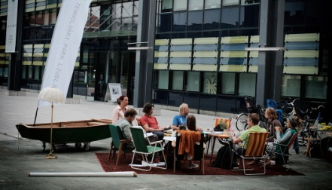
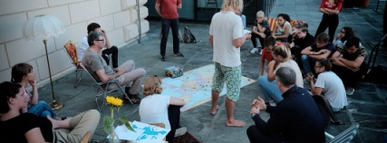
Living lab

Slide 7
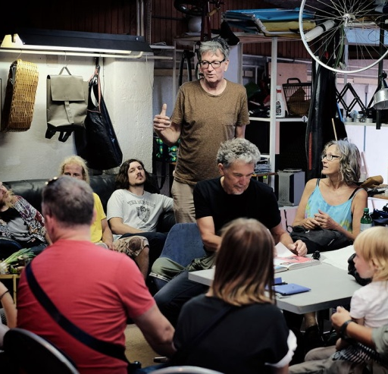
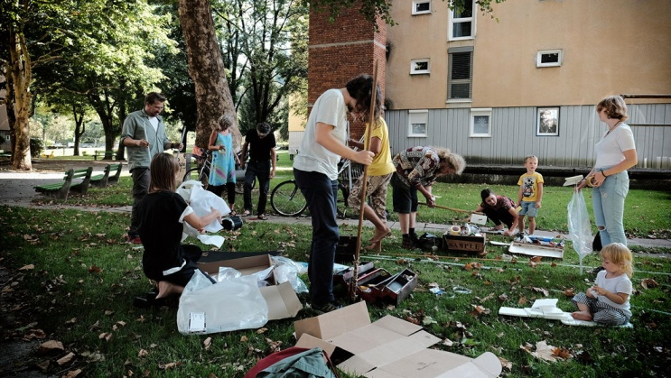
development of ideas and tools

Slide 8
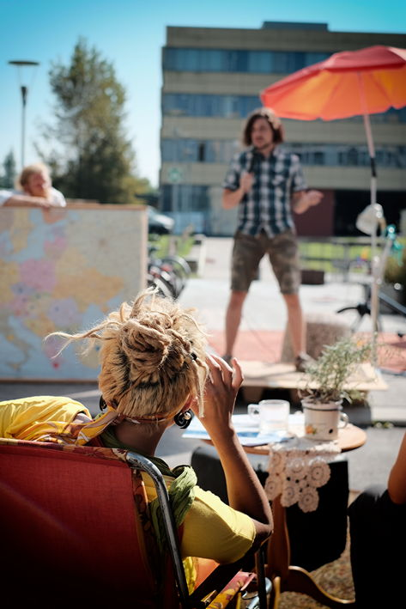
Bootcamp - Pithing event

Slide 9
Centre for Creativity
Centre for Creativity (CzK) is an interdisciplinary platform that connects, promotes, presents and supports the activities and development of Slovenia’s cultural and creative sector (CCS). With its programmes, the Centre works to develop the potentials of the sector’s social and economic value and its autonomy while forging stronger ties between the CCS and the business, science, education and other sectors.

Slide 11
Centre for Creativity & support for CCS in Slovenia
Centre for Creativity - Platform
5,600.000 EUR is run by the MAO
long-term operation of the national hub for the cultural and creative sector (CCS)
Project 1
Financial support of the Centre for Creativity (CzK)
5,300.000 EUR
in the form of grants aimed at promoting entrepreneurship in the CCS and establishing stronger cooperation with the business sector.
Project 2

Slide 12
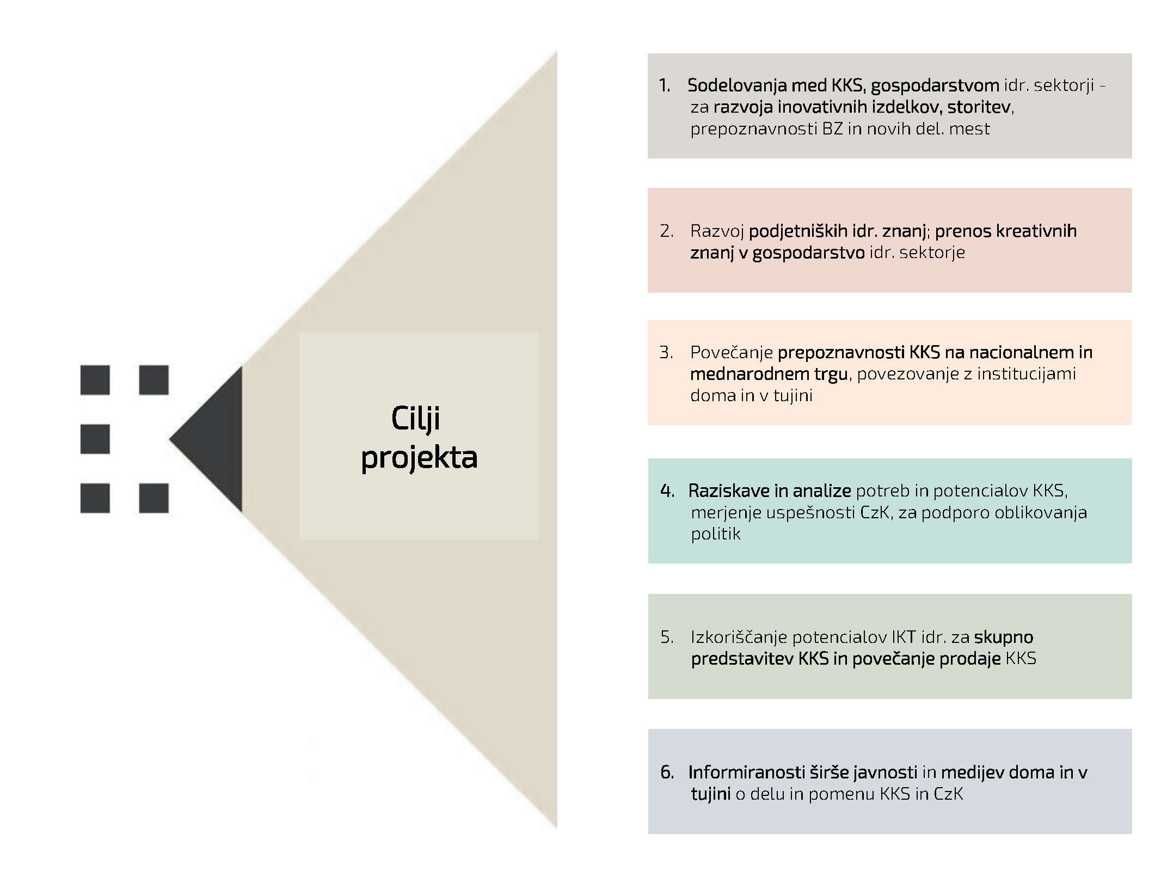
Cooperation between the CCS, the business sector and companies, the public and the private sector, and support environment actors,
The development of entrepreneurial and other skills for accelerated growth and development of the CCS,
The Centre will facilitate
Stronger presence and increased visibility of companies and CCS stakeholders on the national and international markets
Analyses of the sector’s needs and potentials with the purpose of fostering its development and offering support in shaping the CCS policies
Exploitation of the potentials of technologies for a joint presentation of the CCS and improved sales of products and services in the CCS
Increased interest and awareness of the general public and the media (domestic and foreign) of the CCS.

Slide 13
MENTORSHIP
LECTURES
SELLING AND PROMOTIONS
Thank you for the opportunity to build a bridge between creative sector and business community

Slide 14
ChIMERA
Final event
THANK YOU
Venue : Trieste Terminal Passeggeri - Centro Congressi Molo IV - Sala 3
date 26 – 27 SEPTEMBER 2019
Aleš Pevc
Technology Park Ljubljana
ales.pevc@tp-lj.si

