Slide 1
FINAL EVENT ChIMERA PROJECT
Trieste, Italy
26/09/2019
GIORDANO Julie
Project Manager
CCI Nice Côte d’Azur
Julie.giordano@cote-azur.cci.fr

Slide 2
Subtitle
Text
Text
Subtitle
Text
Text

Slide 3
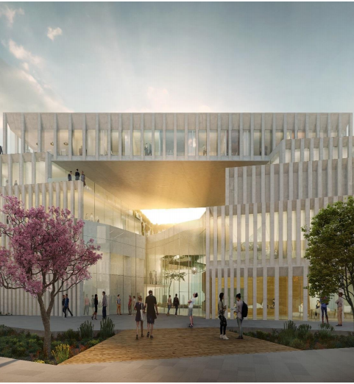
Cannes
Image & Creative Economy Technopole
CCI Nice Côte d’Azur answered to the Call for Tenders to Manage “La Cité des Entreprises de l’image” in Cannes :
Coworking space
Incubator
Office Space
Business Center
Maker Space
Auditorium
Postproduction Studio
…

Slide 4
Event:
FINAL EVENT ChIMERA PROJECT
Trieste, Italy
26/09/2019
GIORDANO Julie
Project Manager
CCI Nice Côte d’Azur
Julie.giordano@cote-azur.cci.fr

